Slide 1

Dayne | Elliot | Emma | Cameron | Suzanne

Slide 2


The mySpy Team
Dayne
Getaway Driver
Elliot
Gadget Specialist
Emma
Night-Owl Operative
Cameron
Sleep-deprived Spy
Suzanne
Hacker

Slide 3



Overview
In an age where digitized privacy for spies is becoming nonexistent, the demand for anonymity, secure communication, and distribution of contracts from handlers to spies is higher than ever.
We can provide encrypted channels for Handlers to release contracts that any spy with matching markers can claim.
A secure and anonymous messaging platform for spies to contact each other.
Private and encrypted direct messaging between spies or handlers.
Able to grant access to other spies and handlers to your private encrypted key
Elliot

Slide 4


In-Scope for 1.0
Contract Listings – Users can post and accept spy-related job contracts.
Direct Messaging – Secure one-to-one communication between users.
Contact via Listings – Option to reach out directly to the poster of a contract.
Search and Connect – Ability to search spies and initiate conversations.
Emma

Slide 5

Out-of-Scope for 1.0
Interactive Spy Map – Location based feature where spies pin activity zones.
Spy Gadget Marketplace – A buy/sell platform for spy gear.
Emma

Slide 6
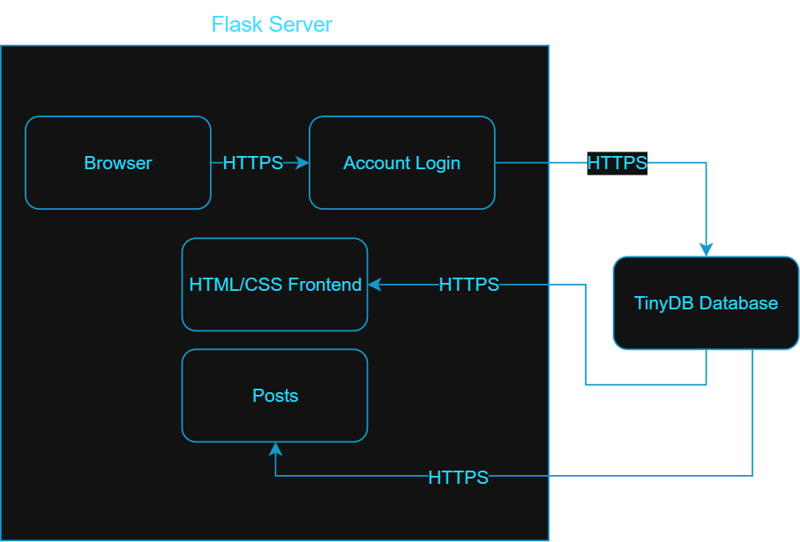
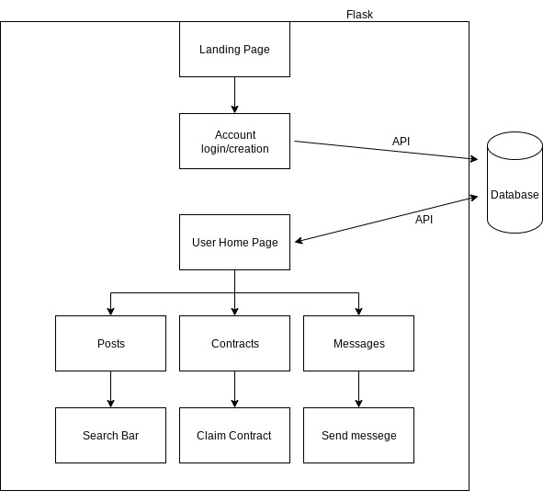
ARCHITECTURE
Browser
Flask as a server​
Database​
HTML/CSS Front-end
Dayne

Slide 7
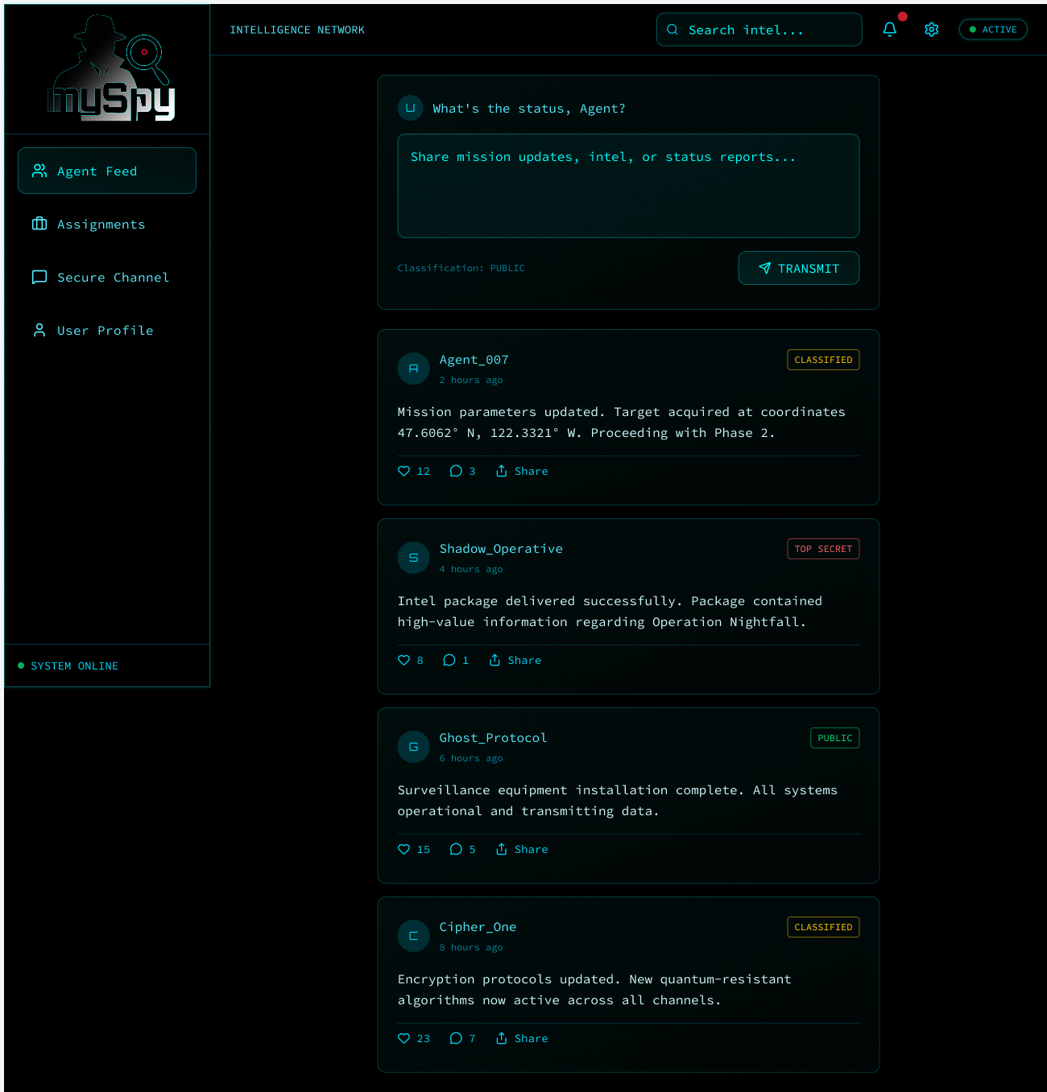
UI Mockup
Link to Live HomePage
Suzanne

Slide 8


M yspy: Stay Hidden. Stay Connected.
All in one place for all your spy needs.
Contact other spies and handlers.
Find handlers in your area.
Post securely, building your reputation.
Questions?

